Slide 1
RippleWealth
AI-Driven Investment Risk Intelligence Platform
Sprint 0 Deliverable:
Computer Science Capstone Project CS 691
Prof. Kshitij Sharma
Spring 2026
Group 8:
- Sharvani Kadarla
- Deepali Sawant
- Jai Sheel Bhasker Paladugu
- Ashish Reddy Majjigapu

Slide 2
Team Member Roles & Responsibilities
Project Manager & Software Developer
Sharvani Kadarla
Define project vision, roadmap, and milestones
Plan sprints and assign tasks efficiently
Design overall system architecture and data flow
Ensure integration across frontend, backend, and AI components
Monitor project progress and resolve blockers
Frontend & Visualization Engineer
Deepali Sawant
Build interactive user interface using Streamlit (or alternatively using HTML, CSS, JavaScript, or other frontend frameworks like ReactJS)
Design dashboards and portfolio visualizations
Implement Knowledge Graph visualizations for event impact
Ensure usability, clarity, and professional UI/UX
Integrate frontend with backend APIs and AI outputs

Slide 3
Team Member Roles & Responsibilities
AI / Machine Learning Engineer
Jai Sheel Bhasker Paladugu
Design and implement AI-driven causal reasoning models
Model Butterfly Event propagation across industries and companies
Construct and manage causal graphs for event impact analysis
Use Large Language Models (LLMs) for explainable insights
Run scenario simulations and portfolio risk analysis
Backend & Data Engineering Lead
Ashish Reddy Majjigapu
Develop RESTful APIs using FastAPI
Implement data ingestion pipelines from APIs or mock datasets
Handle data preprocessing, validation, and storage
Support portfolio risk calculations and stress-testing computations
Ensure backend performance, scalability, and reliability

Slide 4
Problem Statement
Modern investment platforms are reactive — they alert investors only after stock prices change
They do not consider early real-world signals like supply chain disruptions, weather events, labor strikes, or logistics delays
Current tools focus mainly on financial indicators and ignore non-financial risk triggers
Investors lack clear explanations of why their portfolio risk is increasing
As a result, users cannot anticipate risk or make proactive portfolio decisions

Slide 5
Project Description
RippleWealth is an AI-driven investment risk intelligence platform that anticipates market risks by detecting real-world disruptions—such as weather events, supply chain delays, and labor strikes—before they appear in stock prices. Unlike traditional investment tools that react only after price changes, RippleWealth provides early insights to help investors understand potential portfolio impacts.
Using a multi-agent AI architecture and LLM-based causal reasoning, the platform maps how these events propagate across industries and impact companies and portfolios. Through an interactive Knowledge Graph and explainable risk metrics like Value-at-Risk (VaR), RippleWealth enables proactive, transparent, and data-driven portfolio risk management.

Slide 6

Persona: Retail Investor (Young Professional)
Ethan Miller is a 29-year-old software engineer and early-career investor who actively manages his personal investment portfolio. He is comfortable with technology and prefers data-driven tools that help him understand market behavior and portfolio risk. He wants simple visual dashboards, scenario simulations, and clear Value-at-Risk insights to support smarter investment decisions. However, he finds most financial tools either too complex or too fragmented. His primary goal is to use RippleWealth to simulate market stress scenarios, understand downside risk, and make safer long-term investment choices.

Slide 7

Persona: Financial Risk Analyst (Professional User)
Sophia Chen is a 38-year-old financial risk analyst working in a high-pressure, data-intensive environment where accurate risk modeling is critical. She regularly evaluates portfolios, market shocks, and inter-company dependencies using quantitative techniques. She needs advanced tools that support Monte Carlo simulations, causal relationship mapping, and large-scale scenario testing. Her main challenge is that existing tools are time-consuming and lack integrated risk propagation analysis. She uses RippleWealth to run deep simulations, analyze systemic risk paths, and generate faster, more explainable risk reports.

Slide 8

Persona: Business Owner / Wealth Planner
Carlos Ramirez is a 45-year-old small business owner who manages both business and personal investments. He closely follows economic events and sector trends but struggles to understand how global disruptions ripple across industries and affect his holdings. He prefers visual and scenario-based tools rather than purely statistical outputs. His frustration is the lack of clear cause-and-effect visibility in traditional finance platforms. He uses RippleWealth to visualize impact chains, evaluate sector dependencies, and stress-test investment strategies so he can build more resilient financial plans.

Slide 9
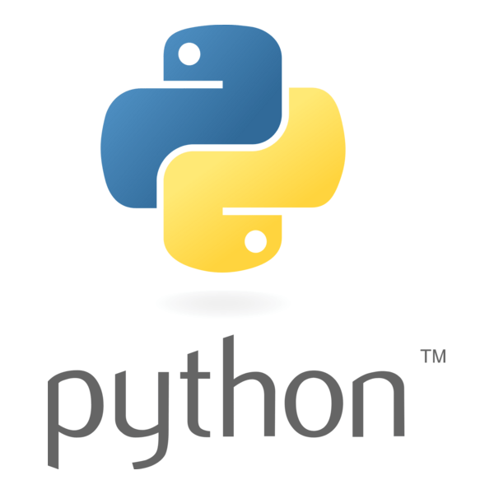
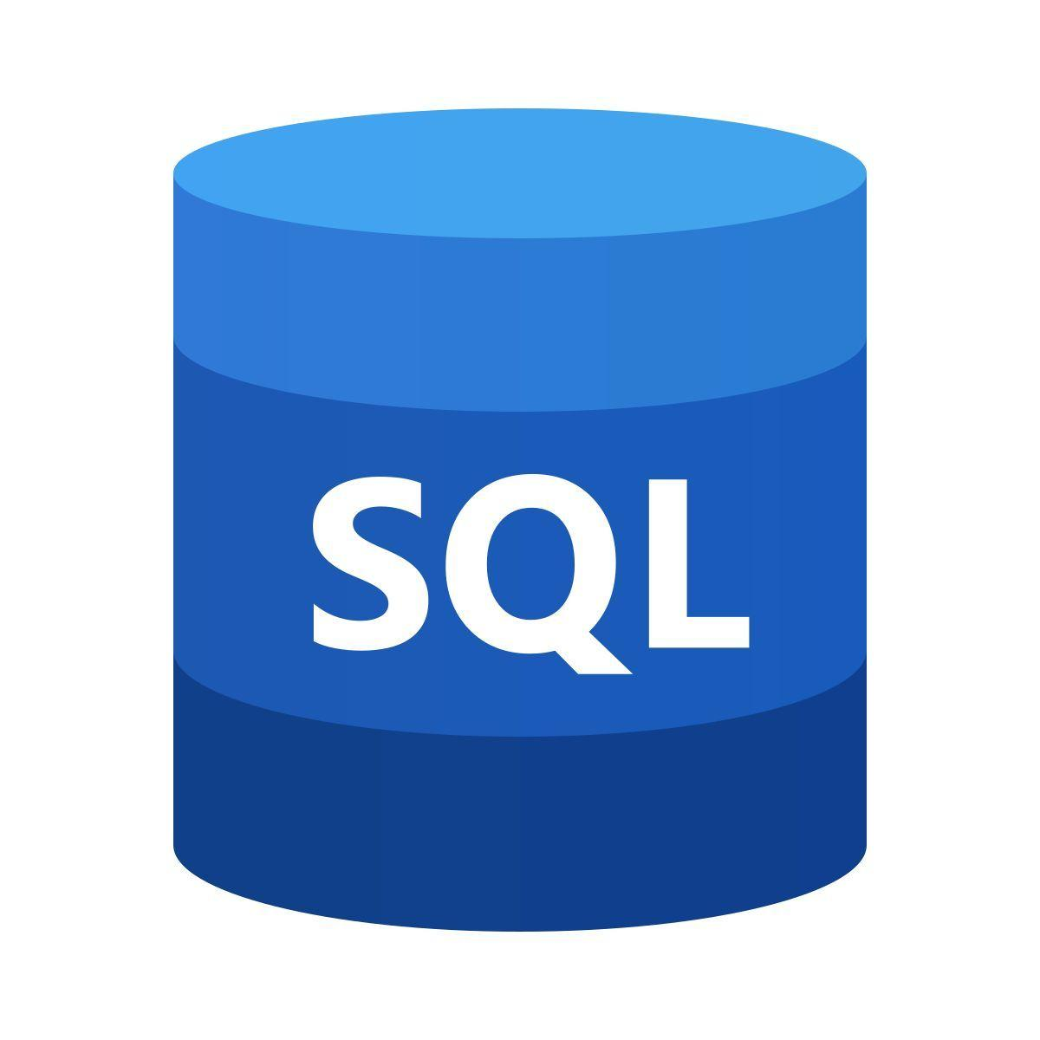
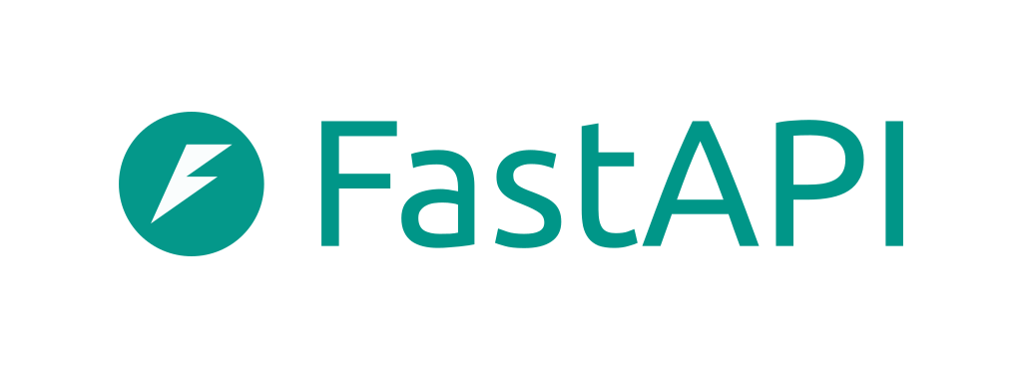


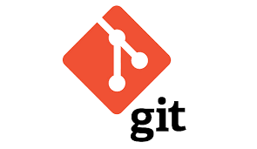

Technologies
Core Technologies
Tools and Platforms

Slide 10
Algorithms
Monte Carlo Simulation — Portfolio Risk Modeling
Computes portfolio Value-at-Risk (VaR)
Simulates thousands of possible market stress scenarios
Estimates potential downside loss under uncertainty
Causal Graph Modeling (Graph Theory)
Builds event → supply chain → company relationship graphs
Identifies direct and indirect impact paths
Enables disruption impact tracing across industries
Natural Language Processing (NLP)
Extracts “Butterfly Events” from alternative data sources
Processes news, weather, and labor reports
Converts unstructured text into structured risk signals
Large Language Model (LLM) Reasoning
Simulates second- and third-order domino effects
Performs causal chain reasoning across sectors
Generates explainable impact narratives
Bayesian Risk Propagation
Assigns probability weights to impact chains
Updates risk exposure dynamically as new signals arrive
Supports uncertainty-aware decision modeling
Time-Series Forecasting (ARIMA / LSTM)
Predicts short-term volatility trends
Supports stress scenario projections
Enhances forward risk estimation

Slide 11
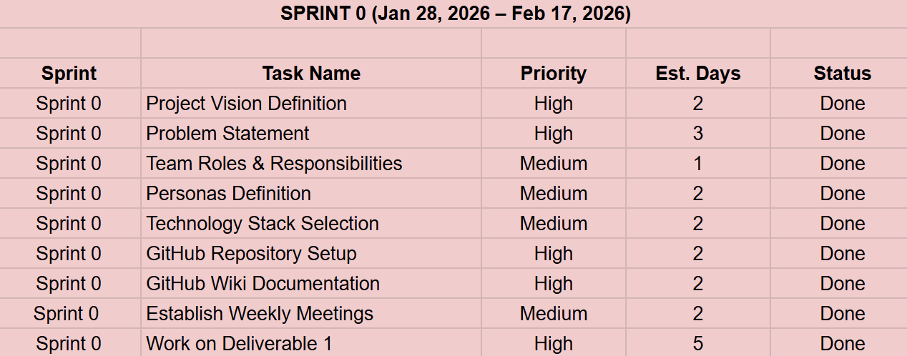
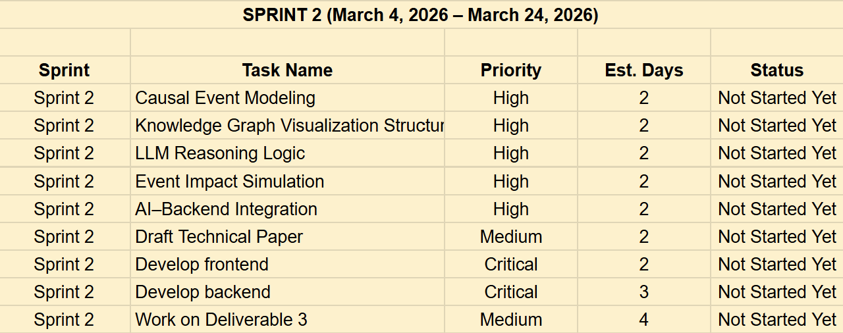
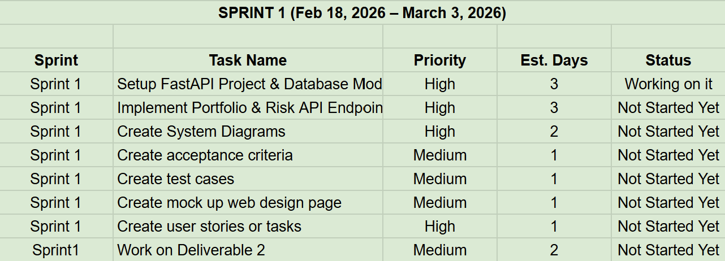
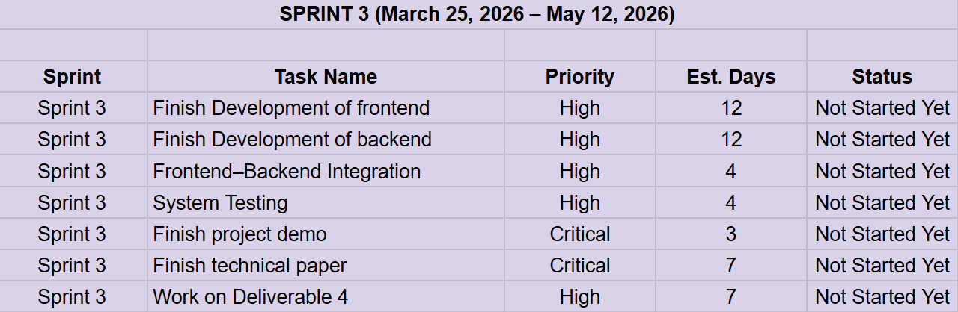
Project Schedule and Cadence

Slide 12
Team Working Agreement
Participation:
Attend all scheduled meetings on time
Come prepared with progress updates
Inform team leader in advance if absent
Meetings:
Weekly meeting (Zoom/Google Meet)
Team leader schedules and shares meeting links
Meeting minutes are recorded after each session
Active participation and idea contribution expected
Work Quality & Collaboration:
Share work early for feedback
Maintain professionalism and accountability
Ensure alignment with project goals
Work Division & Ownership:
Tasks assigned during sprint planning
Equal responsibility distribution
Meet agreed deadlines
Early communication for blockers
Team support during high workload
Communication:
Zoom / Google Meet – Sprint meetings
WhatsApp Group – Quick updates & urgent communication
Google Docs – Collaborative deliverables
Project Tools – Track tasks, bugs, attendance, and plans
Cameras encouraged for transparency and trust

Slide 13
Retrospective
✅ What Went Well
Clear communication helped the team align on the RippleWealth vision and problem statement
Strong collaboration during requirement analysis and persona definition
Well-defined roles and responsibilities improved ownership and accountability
Core technologies and tools were identified, giving clear technical direction
Team recognized early that additional learning is needed for implementation readiness
⚠️ What Can Be Improved
Meeting schedules need better planning to ensure full team availability
More consistent participation is needed from all members during discussions
Task breakdown should be more detailed for better effort estimation
Progress visibility needs to be more structured and regularly updated

Slide 14
Retrospective
Improvement Actions (Added to Sprint 1 Backlog)
Sprint 1 Backlog — Process Improvement Tasks
Action 1 — Structured Mid-Sprint Progress Check-Ins
Conduct one mandatory mid-sprint review meeting
Identify blockers early
Adjust task assignments if needed
Sprint 1 Backlog Task: Mid-Sprint Review Meeting Setup
Action 2 — Better Task Breakdown & Tracking
Break work into smaller, clearly defined tasks
Track progress using sprint boards and issues
Require regular status updates
Sprint 1 Backlog Task: Task Breakdown + Sprint Board Tracking

Slide 15
Retrospective
How We Will Do Things Differently?
Use Slack as the primary communication platform
Encourage peer support and knowledge sharing
Discuss availability and deadlines before each sprint
Assign clear task ownership to ensure accountability
Track progress using GitHub, sprint boards and regular updates

Slide 16
Wiki Page Link
https://github.com/SharvaniKadarla/RippleWealth/wiki

Slide 17
Thank You

